Slide 1


Anatomy of the Cervical Spine
PT5050
Chris Phillips

Slide 2
Contents
Anatomy and physiology of cervical spine
Clinical application
Case notes
Short answer questions

Slide 3
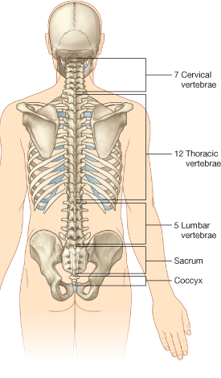
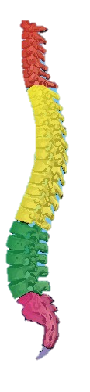
Cervical spine
7 vertebrae
  C1-7
C1 – Atlas
C2 – Axis
Atlanto-occipital joint
Atlantoaxial joint

Slide 4
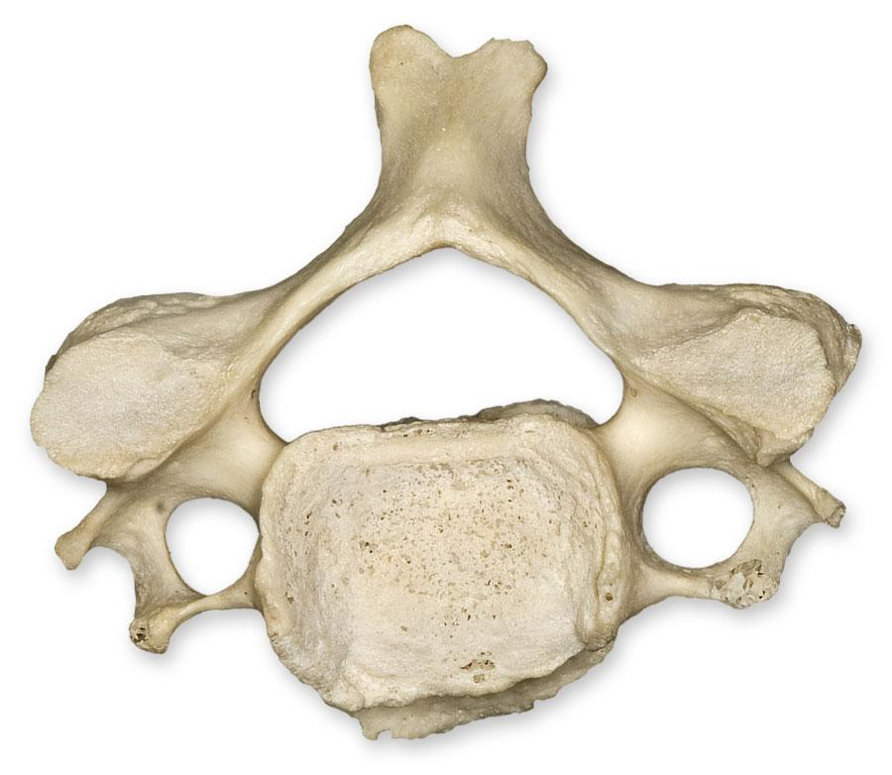
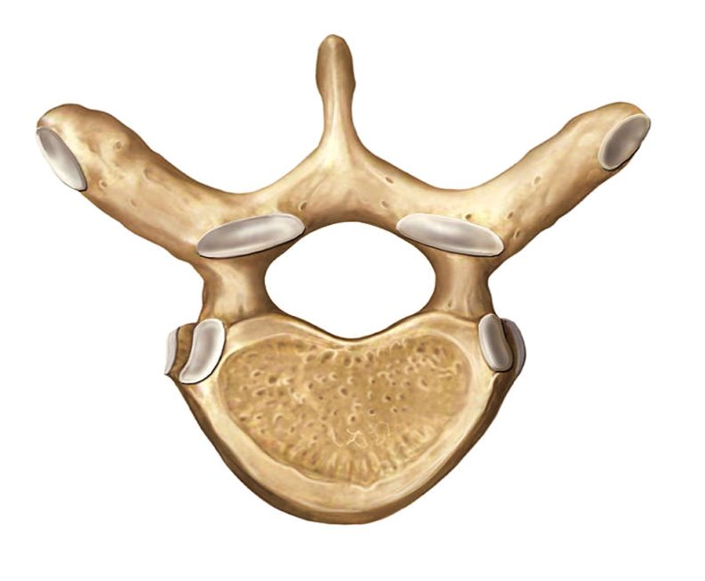
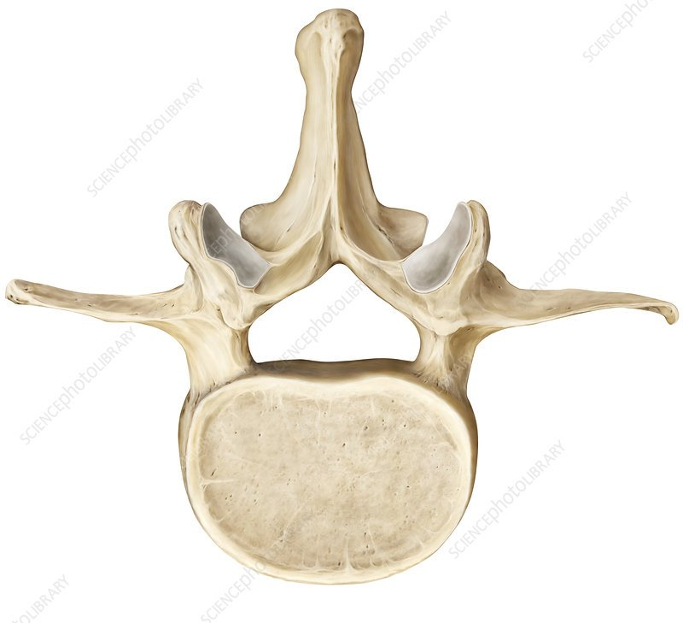
Cervical Vertebrae
In pairs identify differences of cervical vertebrae compared to thoracic and lumbar

Slide 5
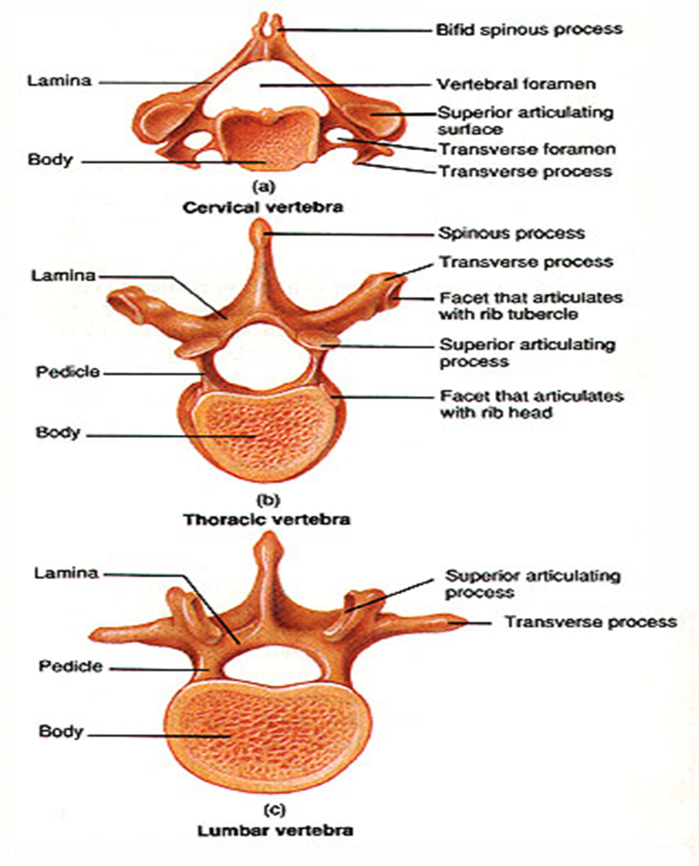
Cervical vertebrae
C3-7 classic vertebrae
Body is small, oval shaped and short in height
Large triangular vertebral foramen
Short pedicle project laterally
Long narrow laminae

Slide 6
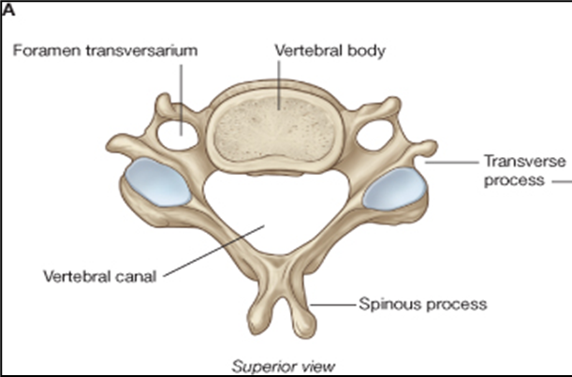
Cervical vertebrae
Short bifid spinous process, muscles attach to nuchal ligament
  C6-7 long SP
  C7 rare to be bifid
Short transverse processes which house foramen transversarium

Slide 7
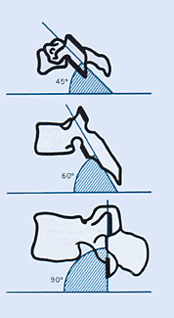
Cervical facet joints
Facet joints lie at approx. 45° angle
Superior facet faces superiorly and posteriorly
Inferior facet faces inferiorly and anteriorly
Allows for all movements

Slide 8
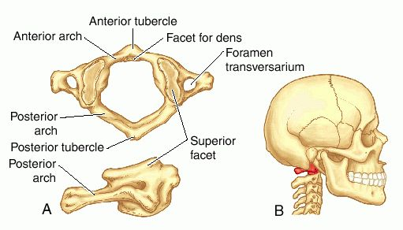
Atlas (C1)
Articulates with Occiput (atlanto-occipital joint) and with the Axis (atlantoaxial joint)
No body or spinous process
Large, wide transverse processes
Superior facets articulate with occiput
Anterior arch which articulates with the odontoid process (dens) of C2
Anterior tubercle origin of anterior longitudinal ligament

Slide 9
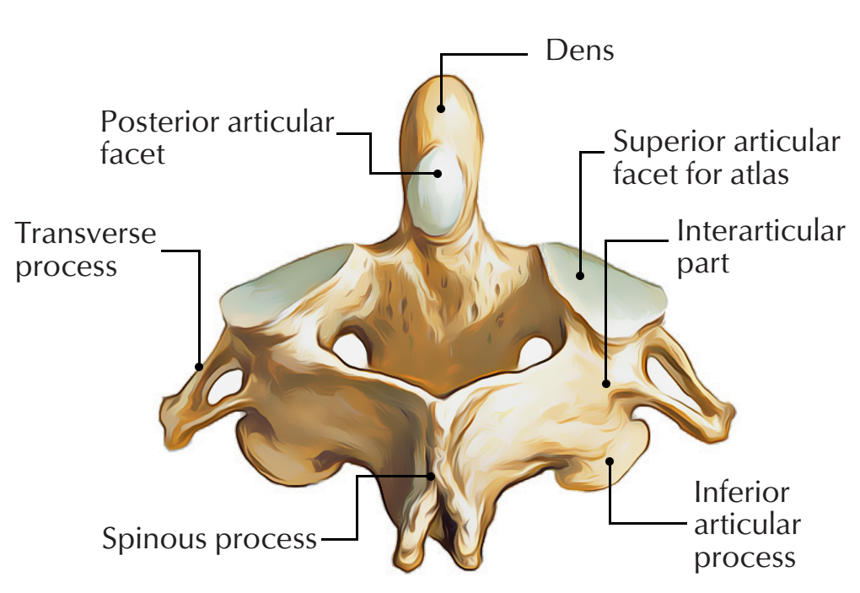
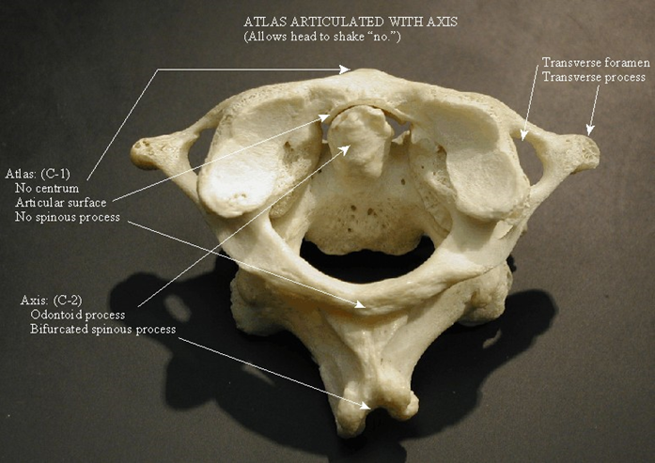
Axis (C2)
Odontoid process (dens) protrudes superiorly and articulates with C1
Bifid spinous process
Superior facets support the weight of head allowing dens to articulate freely with Atlas
Strongest cervical vertebra
Superior facets face up and slightly laterally

Slide 10
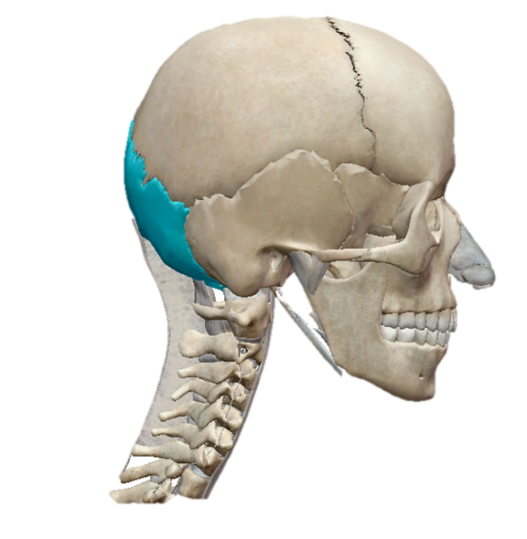
Atlanto-occipital joint
Articulation of superior facets of C1 and occipital condyle
Flexion and extension (nodding)
Lateral flexion
Very minor rotation from occiput ‘slipping’

Slide 11

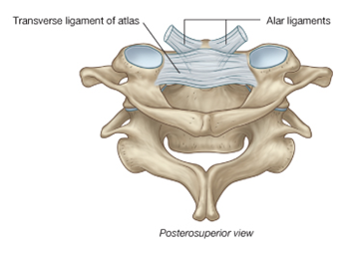
Atlanto-axial joint
Lateral and median joints
Lateral atlanto-axial joint
  Articulation of inferior facets of C1 and superior facets of C2
Median atlanto-axial joint
  Articulation of anterior surface of dens with the posterior surface of the anterior arch of C1
  Posterior surface of dens with the transverse ligament of C1

Slide 12
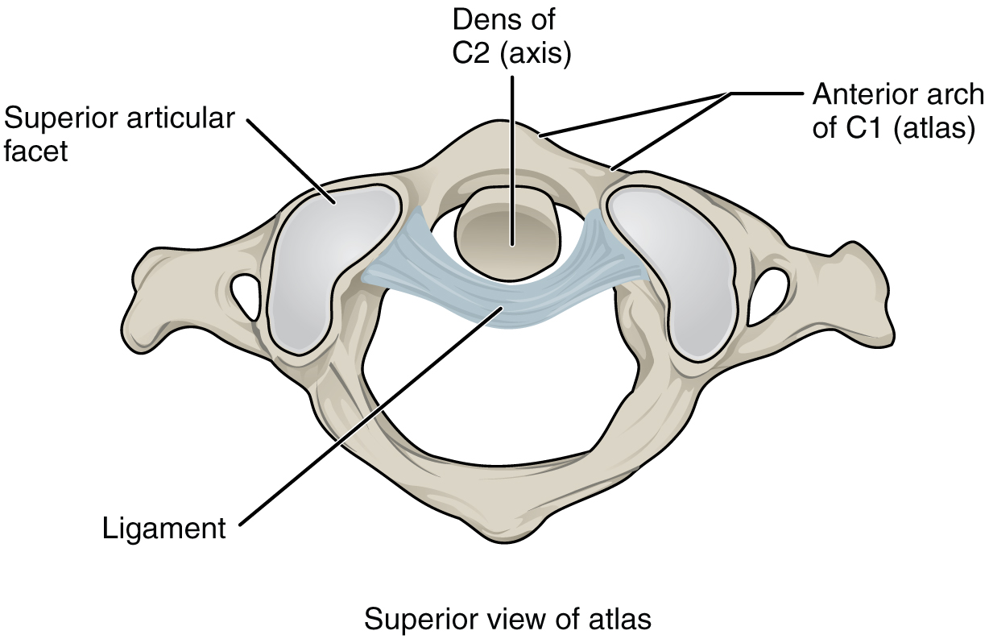
Atlanto-axial joint
Complex movements due to lateral and medial joints moving together
Main movement rotation (shaking head to say “no”)
Atlas spins on its axis
The head and C1 move as a unit on C2

Slide 13
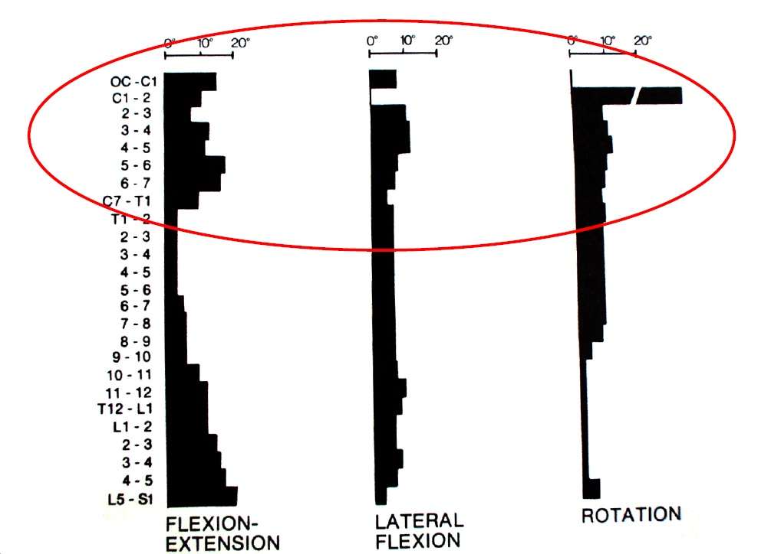

Slide 14
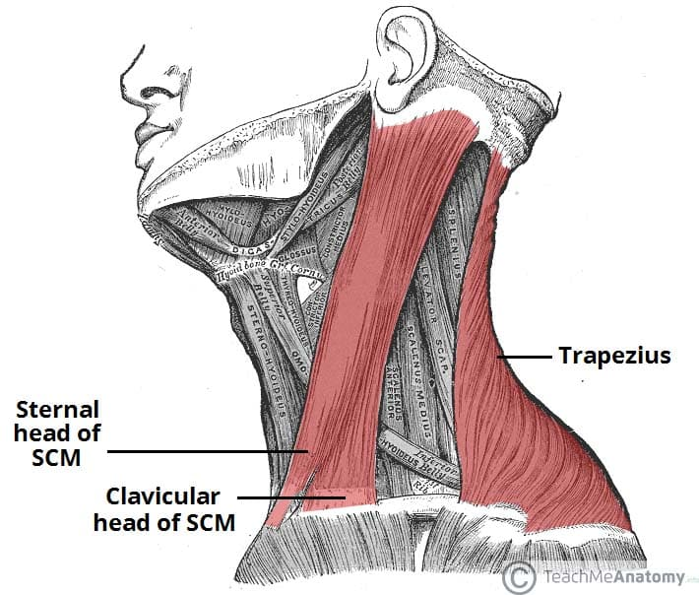
Sternocleidomastoid
Origin – Manubrium of sternum (sternal head), medial 1/3 of clavicle (clavicular head)
Insertion – Mastoid process, superior nuchal line of occiput
Action – Lateral flexion and (contralateral) rotation (unilateral), flexion of neck and extension of head (bilateral)
Innervation – Spinal accessory nerve C1-5.

Slide 15
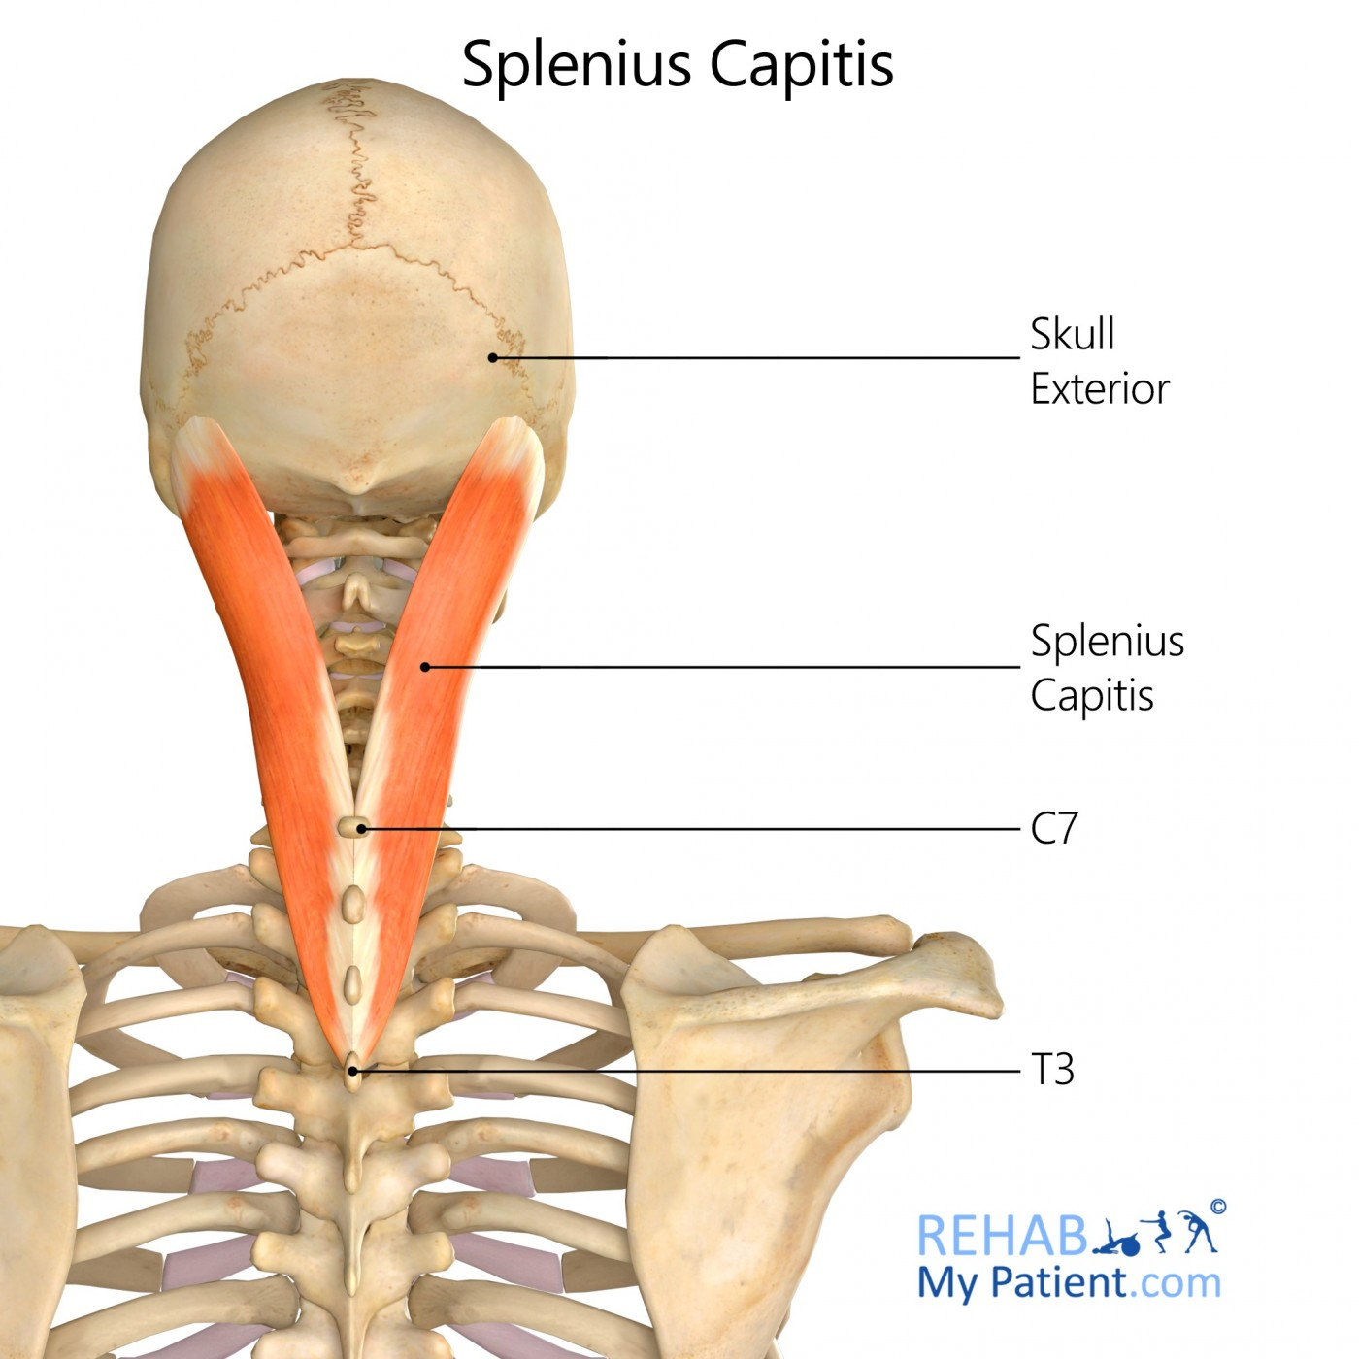
Splenius Capitis
Origin – Lower ligamentum nuchae, C7-T3 spinous processes
Insertion – Mastoid process, superior nuchal line of occiput
Action – Head extension (bilateral), rotation and lateral flexion (ipsilateral)
Innervation – Posterior rami of C2-3

Slide 16
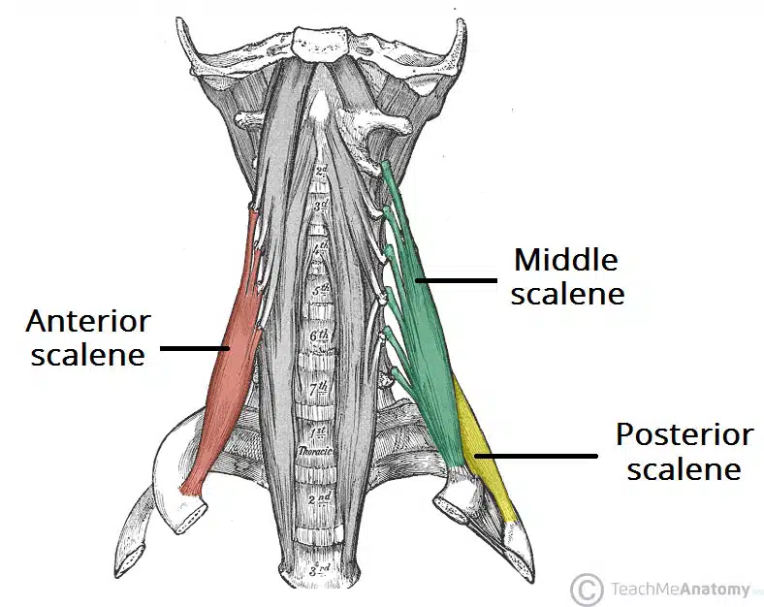
Scalene muscles
Anterior scalene
  O = C3-6 transverse processes
  I = Scalene tubercle of 1st rib
  A = Elevation of 1st rib, lateral flexion (ipsilateral), flexion (bilateral)
  i = C5-7
Middle scalene
  O = C2-7 transverse processes
  I = superior aspect of 1st rib
  A = Elevation of 1st rib, Lateral flexion (ipsilateral)
  i – C3-8

Slide 17
Scalene muscles
Posterior scalene
  O = C5-7 transverse processes
  I = 2nd rib
  A = Elevation of 2nd rib, lateral flexion (ipsilateral)
  i – C7-8

Slide 18
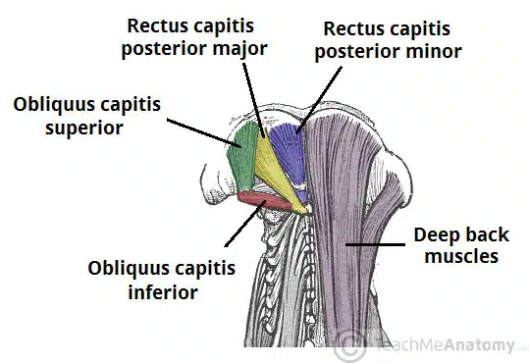
Suboccipital muscles
Rectus capitis posterior major
  O = C2 spinous process
  I = Lateral part of nuchal line of occiput
  A = Extension and rotation of head
Rectus capitis posterior minor
  O = C1 posterior tubercle
  I = Medial part of nuchal line of occiput
  A = Extension of head

Slide 19
Suboccipital muscles
Obliquus capitis superior
  O = C1 transverse process
  I = Occipital bone between superior and inferior nuchal lines
  A = Extension of head
Obliquus capitis inferior
  O = C2 spinous process
  I = C1 transverse process
  A = Extension and rotation of head
Innervation – Suboccipital nerve C1

Slide 20
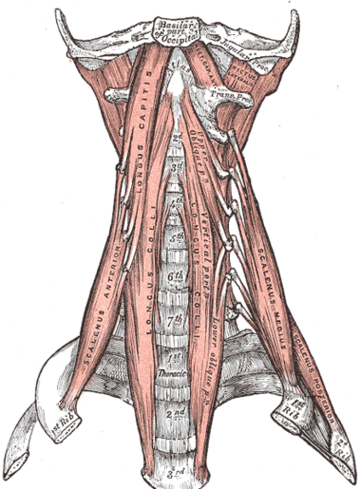
Deep flexors
Rectus Capitis Anterior
  O = Anterior surface of lateral mass of C1
  I = Inferior surface of occiput
  A = flexion
  i – C1-2
Rectus Capitis Lateralis
  O = Transverse process of C1
  I = Jugular process of occiput
  A = Stabiisation of head and lateral flexion
  i – C1

Slide 21
Deep flexors
Longus Capitis
  O = Anterior tubercles of TP of C3-6
  I = Basilar portion of occiput
  A = Flexion (bilateral), ipsilateral rotation/lateral flexion (unilateral)
  i – C1-5
Longus Colli / Longus Cervicis
  O = Anterior surfaces of C3-T3
  I = Anterior arch of C1, anterior tubercles of C5-6, anterior surfaces of C2-4
  A = Flexion (bilateral), ipsilateral lateral flexion and rotation (unilateral)
  i – C3-T3

Slide 22
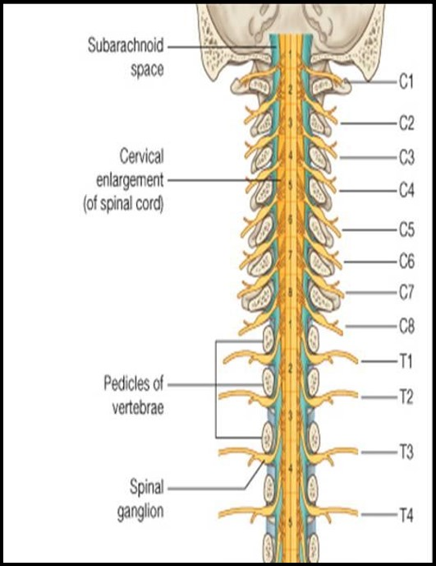
Nerve roots
Lx = 5 vertebrae and 5 nerve roots
Tx = 12 vertebrae and 12 nerve roots
Cx = 7 vertebrae and 8 nerve roots

Slide 23
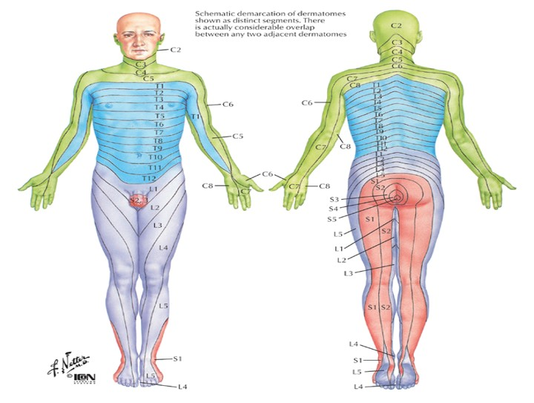

Slide 24
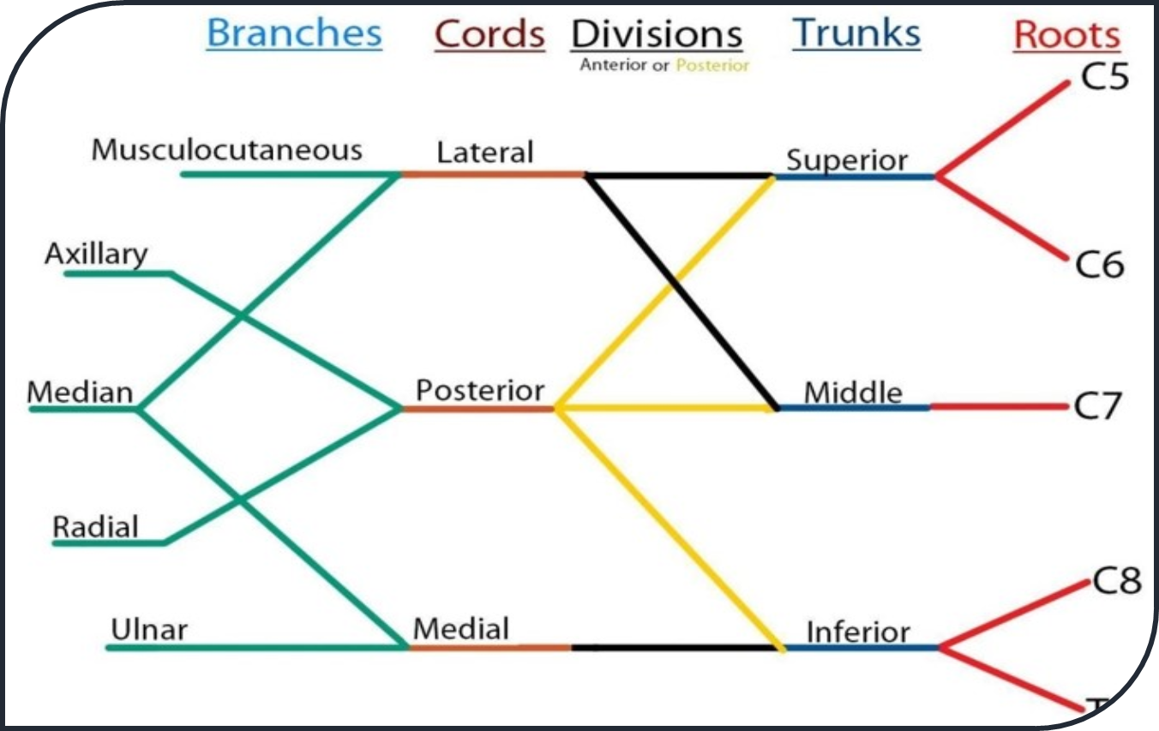
Brachial Plexus
C5-T1 nerve roots
Median nerve
Ulnar nerve
Radial nerve
Axillary nerve
Musculocutaneous nerve

Slide 25
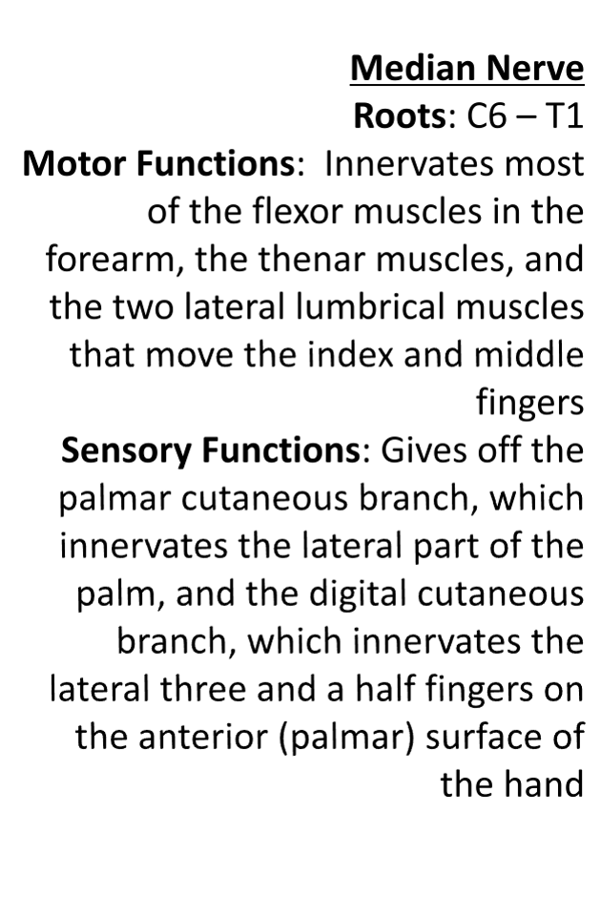
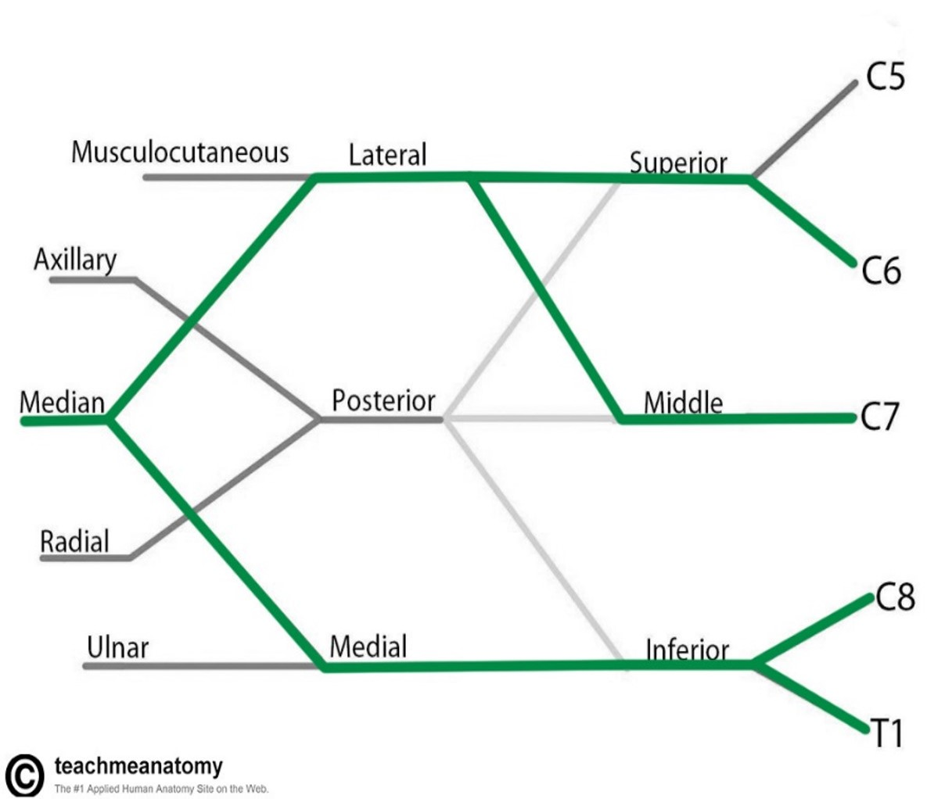
Median Nerve

Slide 26
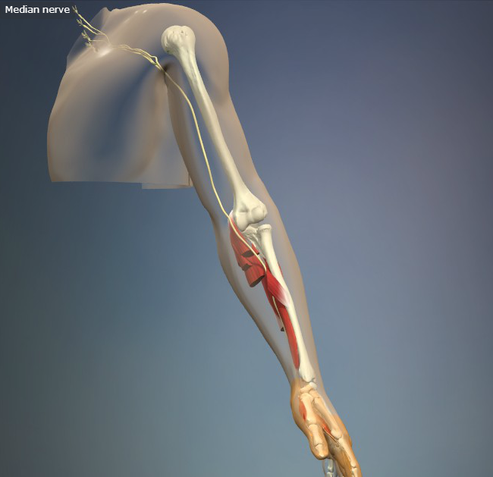
Median Nerve

Slide 27
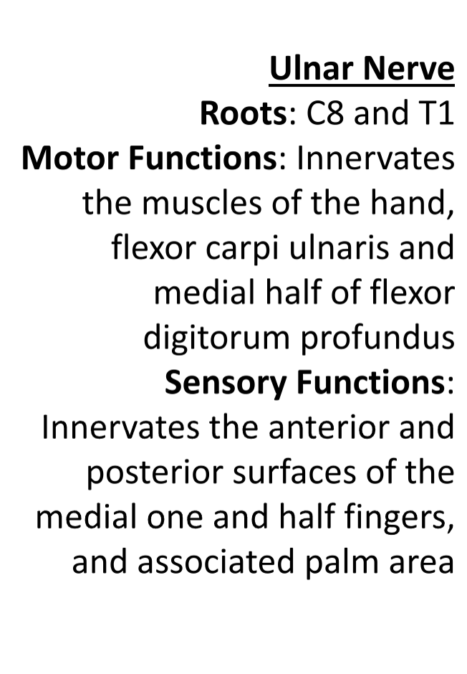
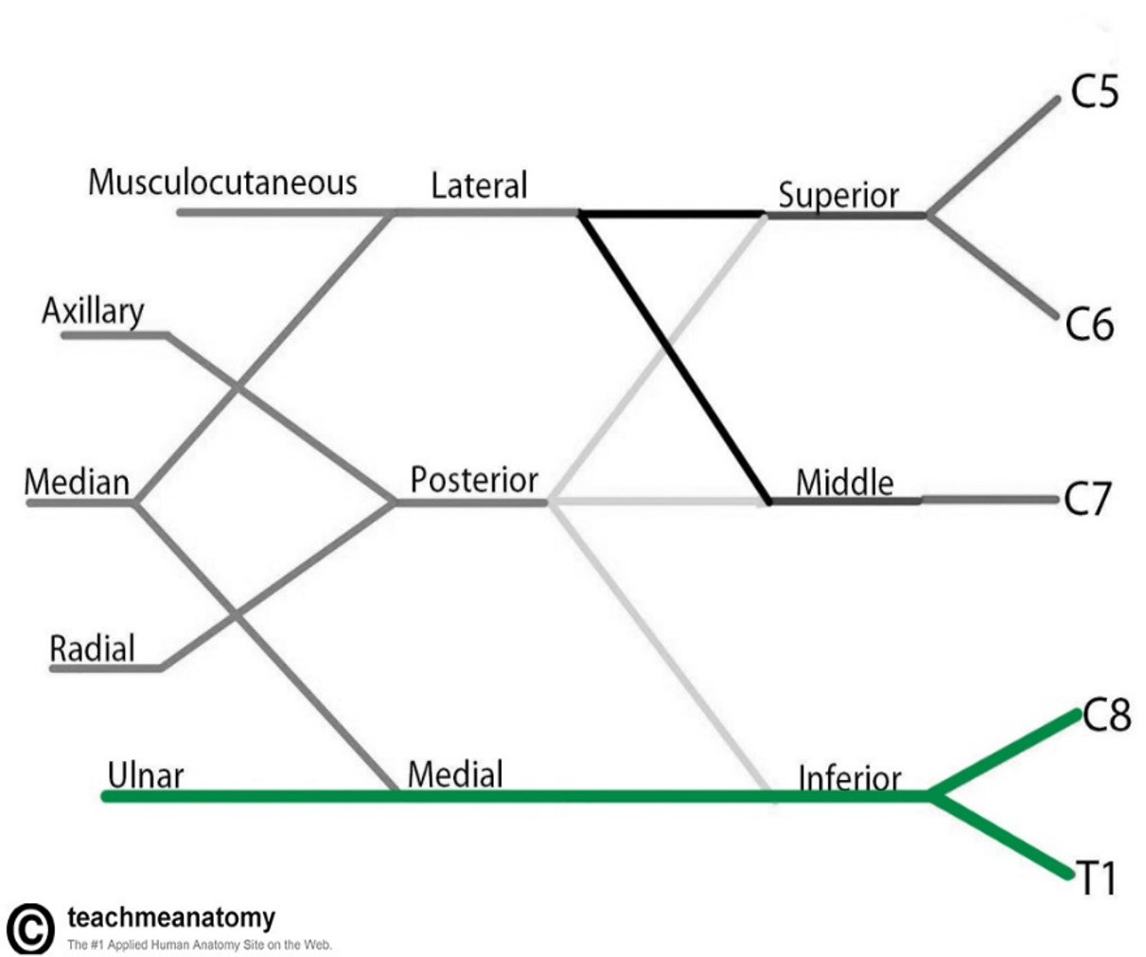
Ulnar Nerve

Slide 28
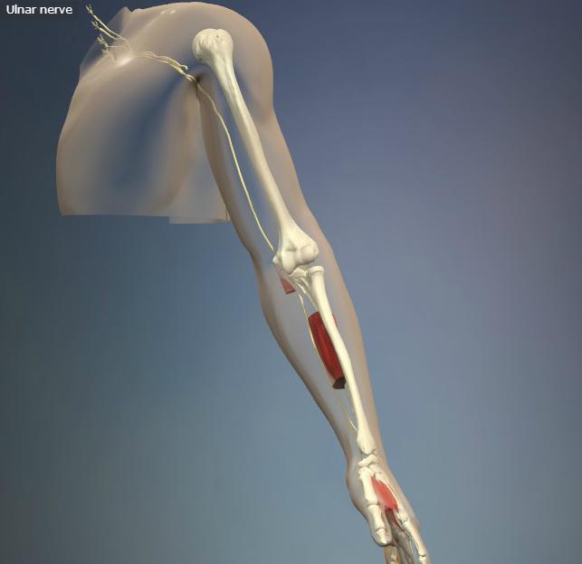
Ulnar Nerve

Slide 29
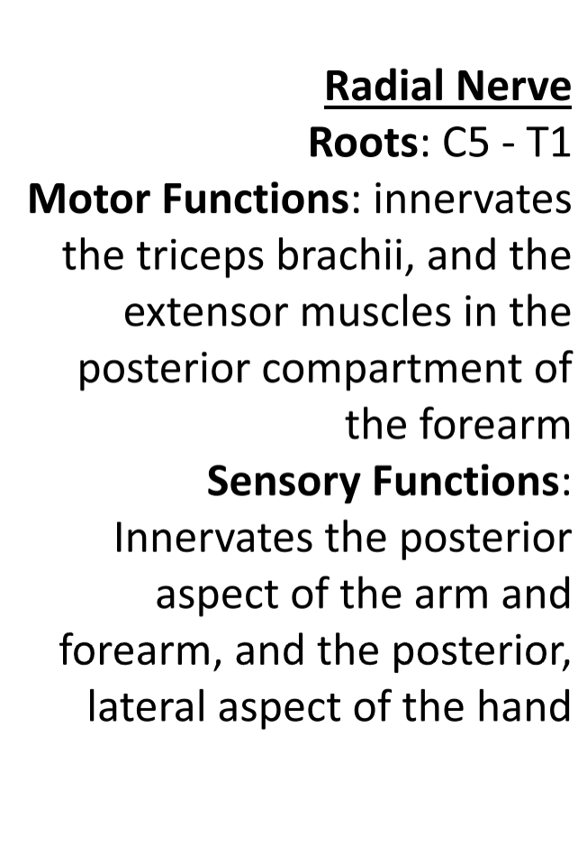
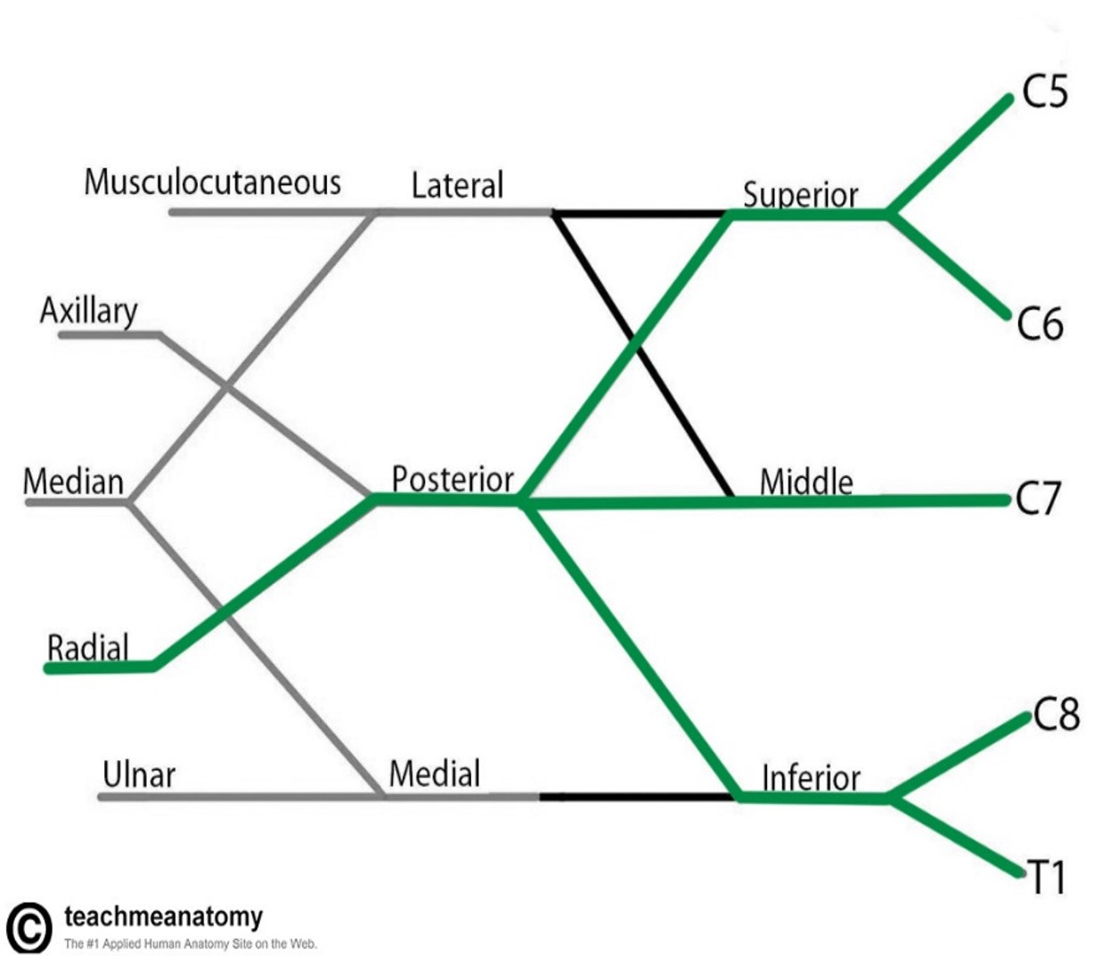
Radial Nerve

Slide 30
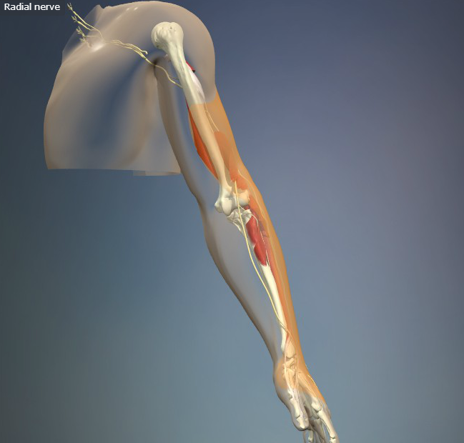
Radial Nerve

Slide 31
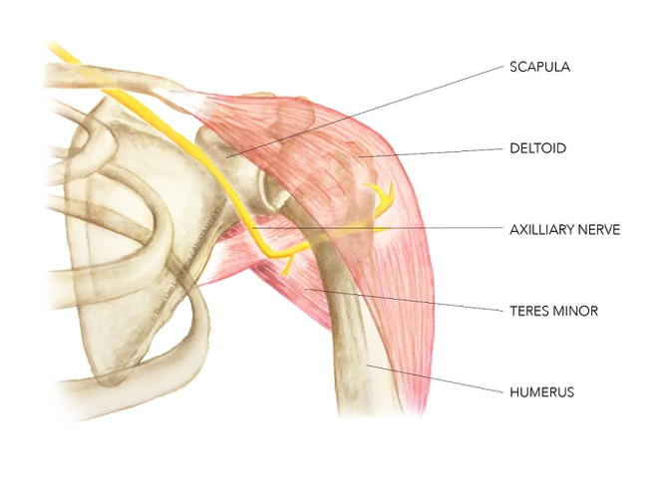
Axillary Nerve
Roots C5-6
Innervates Teres minor and Deltoid
3% to 6% of all brachial plexus pathologies
Usually injured from compressive forces with anterior should dislocation

Slide 32
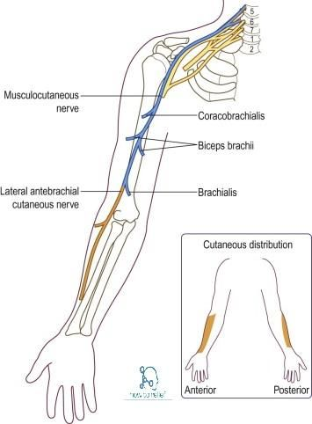
Musculocutaneous Nerve
Roots C5 – 7
Innervates muscles at front of arm and skin of lateral forearm
Innervates Biceps Brachii, Brachialis and Corocobrachialis

Slide 33
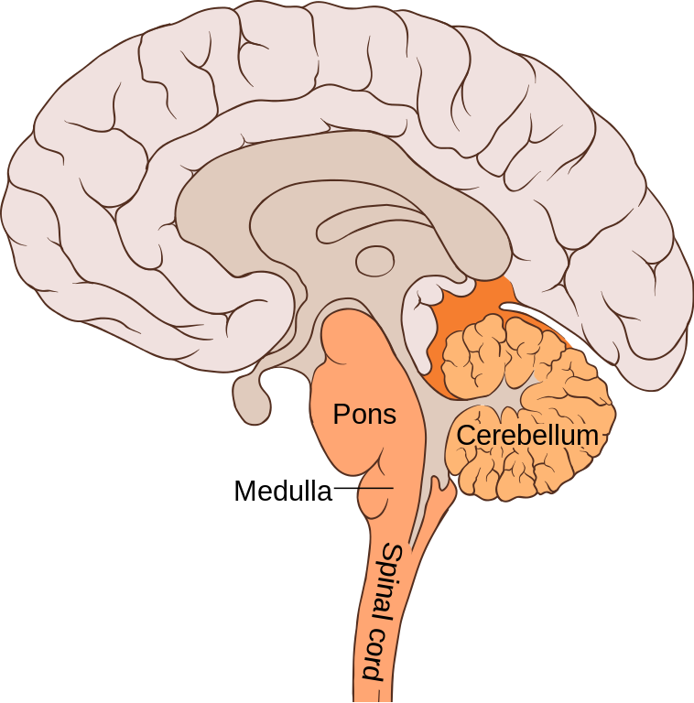
Vertebrobasilar System
Vertebrobasilar artery mainly supplies the hindbrain which is responsible for balance, communication, co-ordination
Can be restricted due to too much movement (rotation) – vertebrobasilar insufficiency

Slide 34
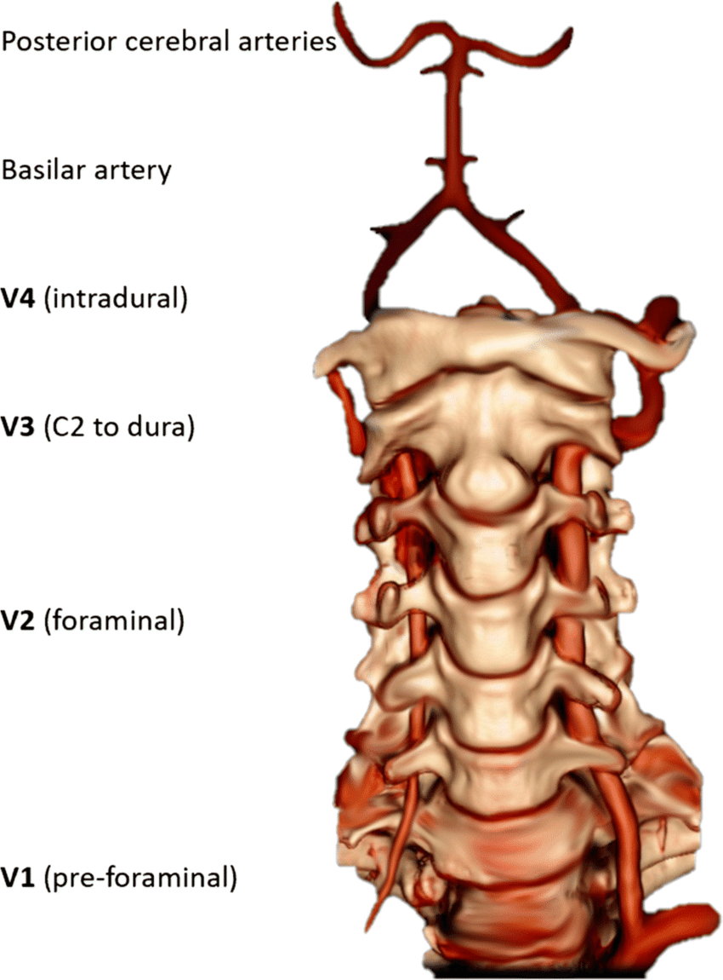
Vertebrobasilar System
Composed of Subclavian Artery, Vertebral Artery and Basilar Artery
Vertebral artery runs through foreman transversarium of Cx and then meets the contralateral VA to form the Basilar Artery
VA kinks between C2 and C1

Slide 35
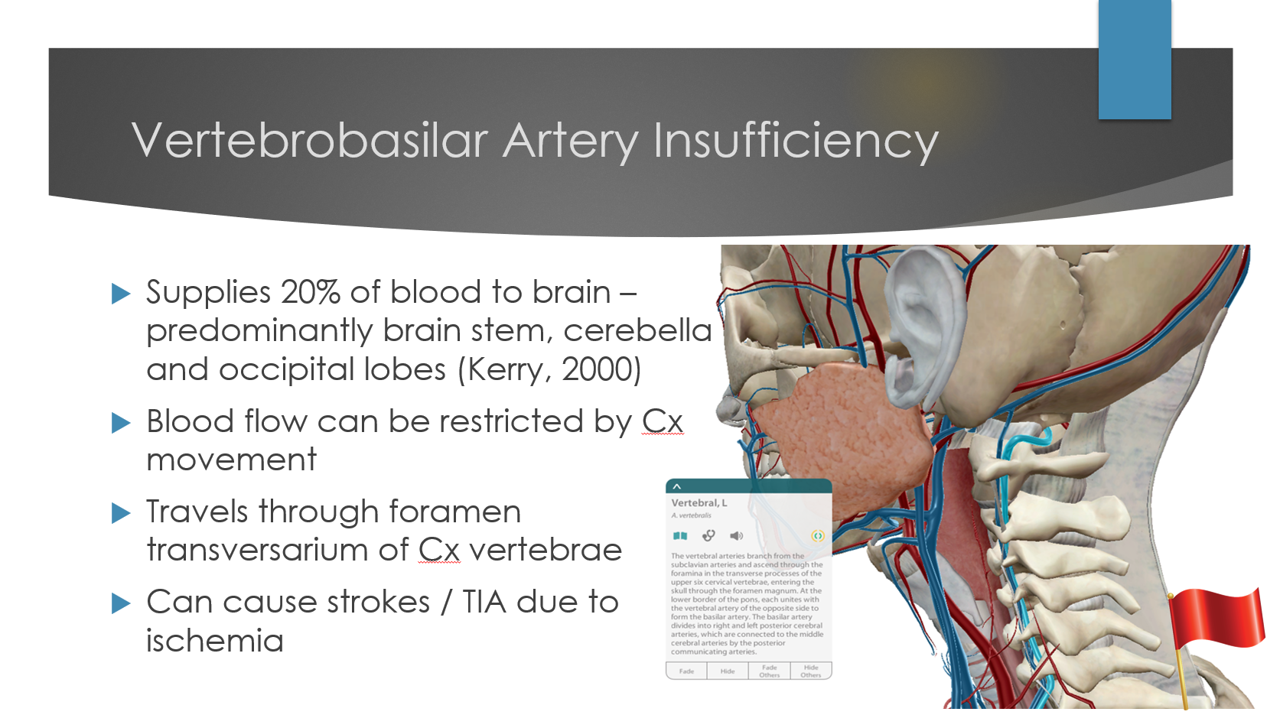

Slide 36
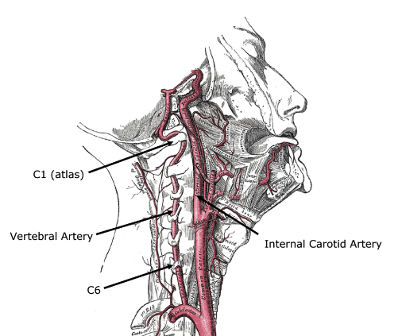
Signs and symptoms of VBI
5 D’s & 3 N’s
Drop attacks
Dizziness
Dysphasia – difficulty swallowing
Dysathria – difficulty speaking
Diplopia – Blurred vision
Nystagmus – uncontrolled eye movement
Nausea
Neurological symptoms

Slide 37


Slide 38
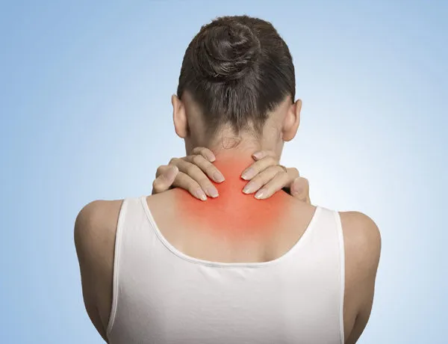
Clinical Application

Slide 39
Common Cx Pathology
Whiplash Injury
Cervical Radiculopathy
Degenerative Disc Disease

Slide 40
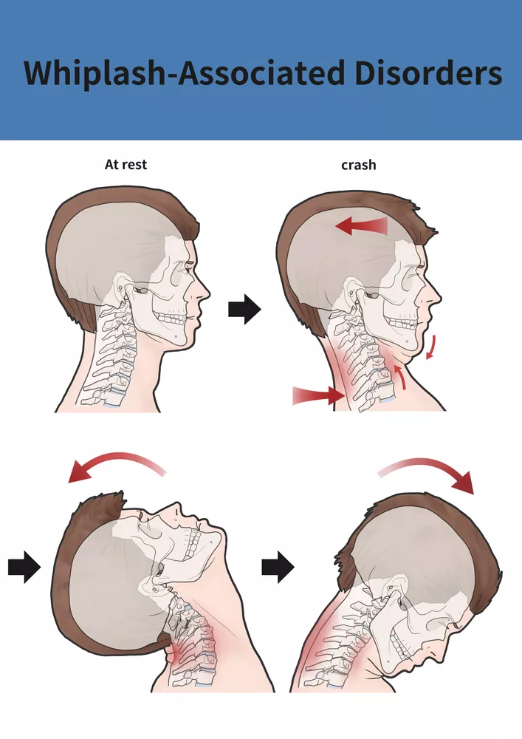
Whiplash - Pathophysiology
Sudden hyperextension and hyperflexion of the neck
Overstretching and damage to cervical muscles and ligaments, joint capsule strain, annular tears, compression/traction of nerve roots and nociceptor irritation.
Release of cytokines during inflammatory response resulting in pain sensitisation.
Increased muscle tone/activity of superficial muscles and inhibition of deep neck flexors
Central sensitisation

Slide 41
Whiplash – Clinical presentation
Symptoms often appear within 24-48 hours
Neck pain and stiffness
Reduced ROM
Headaches
Dizziness or light-headedness
Parathesia in upper limbs
Muscle spasm
Visual disturbance – rare
Psychological effects

Slide 42
Whiplash - Grading
Quebec Task Force Classifications
  Grade 0 – No complaint and no physical signs
  Grade 1 – Complaint of neck (stiffness or tenderness) and no physical signs
  Grade 2 – Neck complaint and MSK signs (ROM)
  Grade 3 – Neck complaint and neurological signs
  Grade 4 – Neck complaint and # or dislocation

Slide 43
Whiplash – Physiotherapeutic intervention
Early mobilisation and education
Avoid prolonged immobilisation
Address psychological factors – fear avoidance
Strengthening of deep flexors

Slide 44
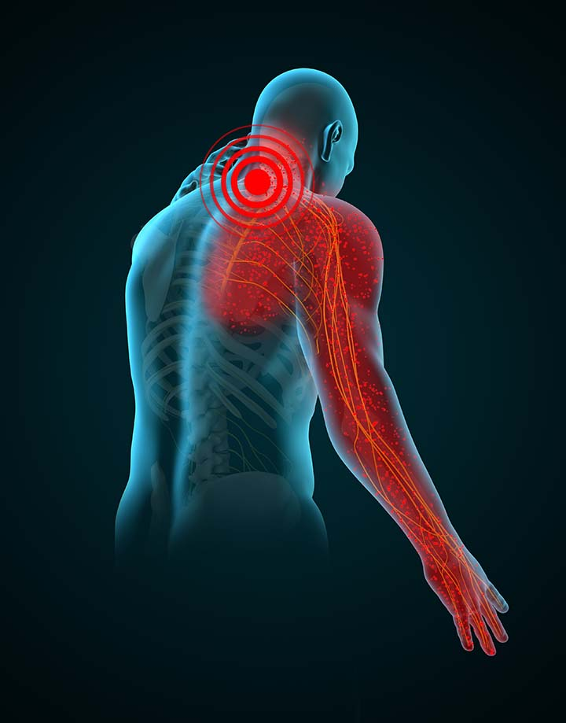
Cervical Radiculopathy
Cervical nerve root compression or irritation
  Disc herniation
  Spinal stenosis
  Other degenerative changes
  Tumours, infection and trauma
Direct pressure causing impaired conduction
Chemical irritation from inflammatory mediators (cytokines, prostaglandins)

Slide 45
Cervical Radiculopathy
Unilateral neck pain
Pain radiating down arm – “sharp, shooting, lancing”
Often accompanied by paresthesia, numbness or weakness in the corresponding dermatome/myotome.
Reflex changes may be present
  Biceps C5
  Brachioradialis C6
  Triceps C7
Pain aggravated by neck movements (especially extension and rotation/lateral flexion to the affected side)

Slide 46
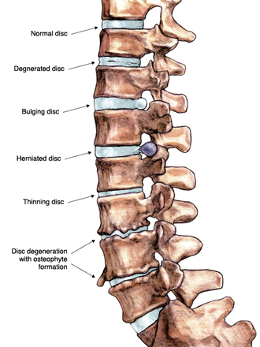
Degenerative Disc Disease - Pathophysiology
Dehydration – loss of proteoglycans causing reduced height
Decreased function and osteophyte formations
Tears in annulus fibrosis leading to disc bulges and herniations
Increased load on facet joints
Ligament thickening – ligamentum flavum
Spinal stenosis
Degenerative tissues release chemical
mediators causing sensitisation of nociceptors

Slide 47
Degenerative Disc Disease – Clinical Presentation
Pain and stiffness with a gradual, insidious onset
Aggravated from prolonged activity/posture
Reduced ROM, often extension and rotation
Radicular symptoms with nerve root involvement
Muscle spasms, headaches

Slide 48
Summary
Cervical vertebrae are smaller than Tx and Lx due to being less weightbearing
C1-occipital, Atlanto-occipital joint (flexion/extension)
C2-C1, Atlantoaxial joint (rotation)
Cervical nerve roots
Vertebrobasilar system passes through the cervical spine
  Be aware of VBI

Slide 49

Case notes

Slide 50
SAQ Advice
Read the questions carefully!
Look at how many marks are available
  Indicates how many points to include or the level of detail needed.
Understanding the meaning of different question terms
  List
  Identify
  Outline
  Describe
  Explain

Slide 51
SAQ Descriptors
List
  Series of points without explanation, brief with no detail
Identify
  Name or recognise something from given information
Outline
  Give a general overview or summary
Describe
  Detailed account of something, including features
Explain
  Provide reasons to show understanding of why/how

Slide 52

Menti

